Slide 1

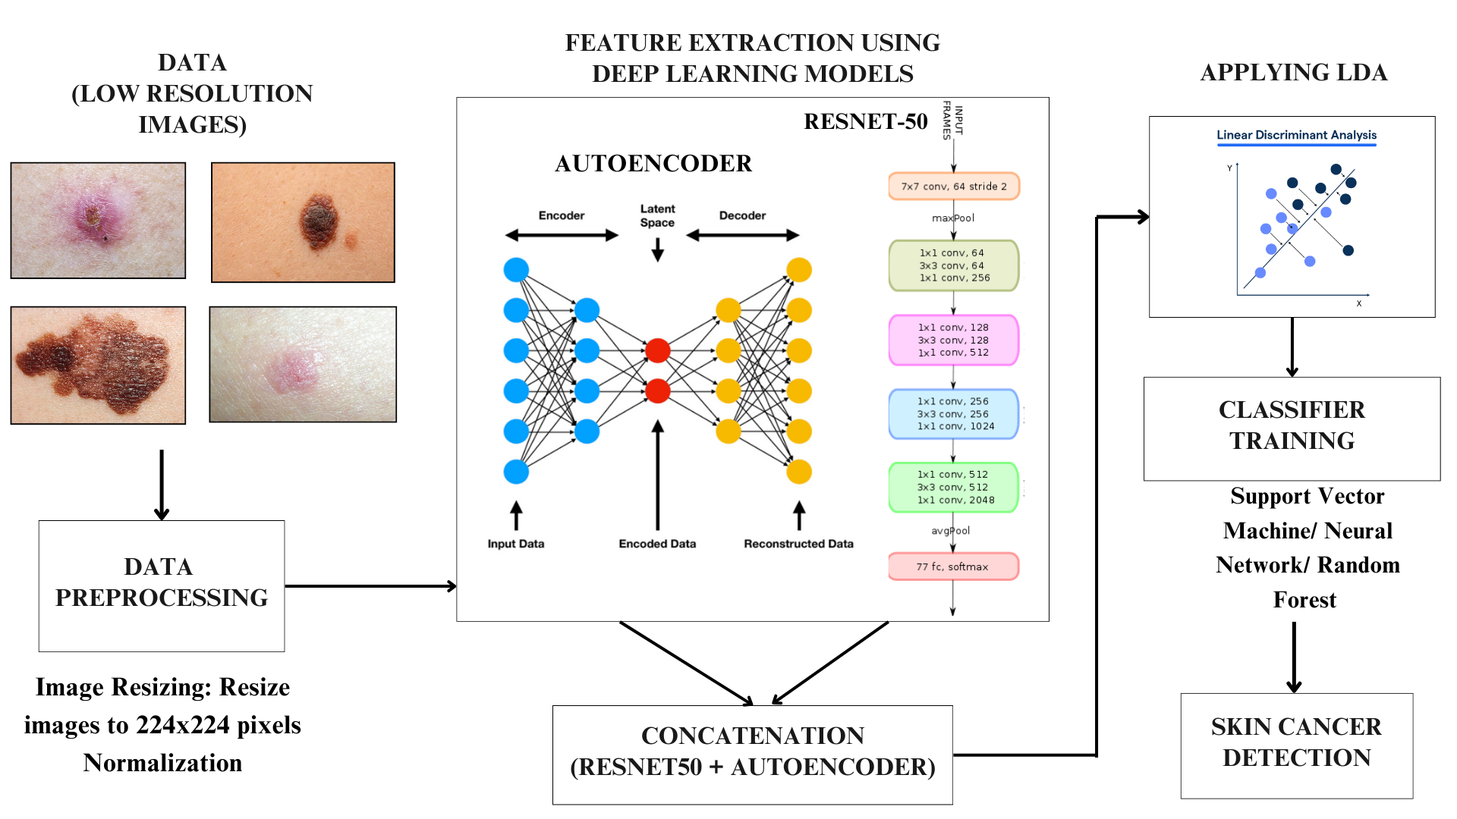
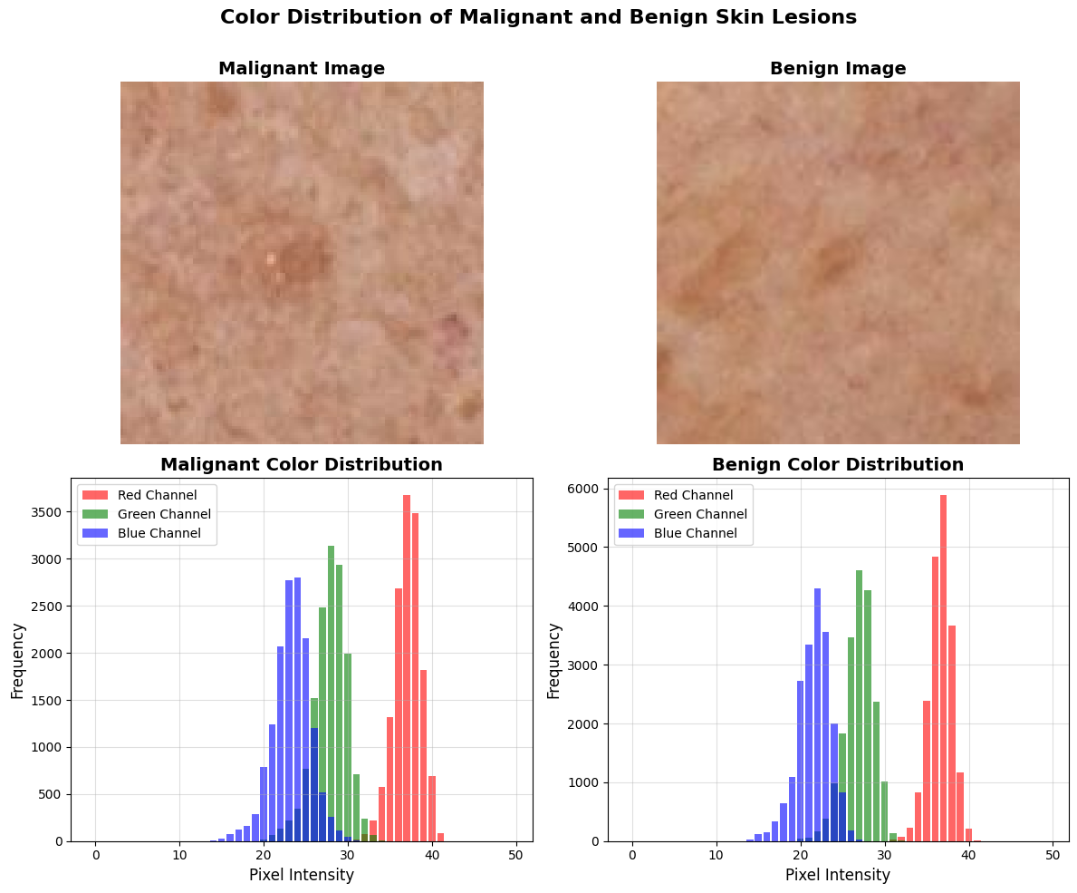
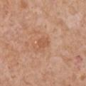
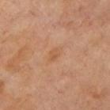
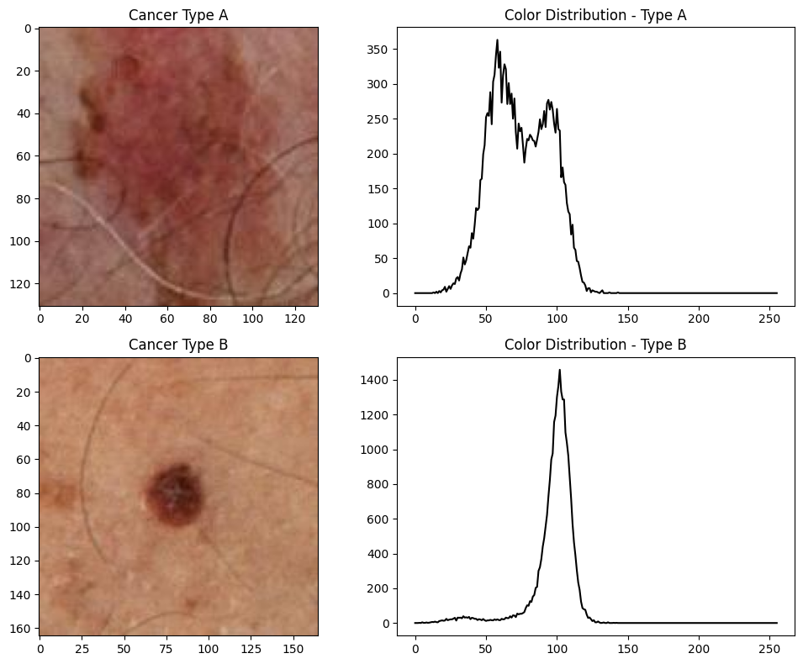
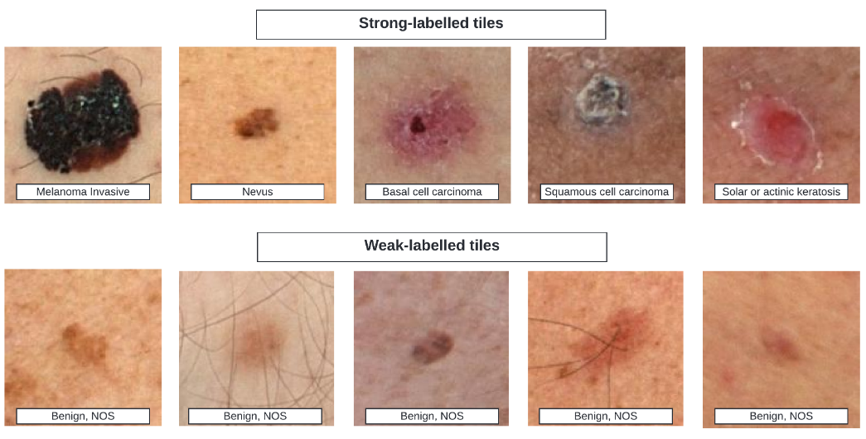
Skin Cancer Detection for Telehealth
Presenter Names: Akash-0043 ,Pravallika-0048, Meghana-0180, Chandhan-2163
Guide Name: Dr. Venkata Ramana Murthy Oruganti (Associate Professor)
Introduction
Methods
Skin cancer is the world’s most common cancer, affecting over 1.5 million people each year. Although melanoma accounts for only 1% of cases, it is the deadliest form, making accurate detection crucial. Traditional exams can sometimes miss signs of melanoma, with even skilled dermatologists reaching around 60% accuracy. While dermoscopy has improved diagnostic capabilities, subtle melanomas remain challenging to identify.
Our project focuses on making skin cancer detection possible in telehealth images. By leveraging machine learning, we aim to enhance accuracy in low-resolution, patient-submitted images, addressing a critical gap in remote skin cancer diagnosis
DATA
(LOW RESOLUTION IMAGES)
VGG16
.
CLASSIFIER
TRAINING
Support Vector Machine/ Neural Network/ Random Forest
DATA
PREPROCESSING
SKIN CANCER
DETECTION
Image Resizing: Resize images to 224x224 pixels
Normalization
RESNET-50
Analyzing Complexity Across Classes
The proposed system enhances skin cancer diagnosis by combining deep feature extraction from an autoencoder and ResNet-50’s conv5_block2 layer. To further optimize classification, Linear Discriminant Analysis (LDA) is applied to maximize class separability. To classify skin lesions, we utilize machine learning approaches such as Support Vector Machines for margin-based classification, Neural Networks for feature learning, and Random Forests for ensemble decision-making
Highlighting Unexpected Similarities Between Malignant and Benign Lesions
Findings and Results
Deep Model | Layer /features | Model Accuracy (%)
 |  | SVM | Neural Network | Random Forest
VGG16 | Block5_Conv3 | 61.64 | 67.30 | 72.33
 | Block5_Conv2 | 76.73 | 73.58 | 75.47
 | Block5_Conv1 | 77.99 | 72.33 | 72.96
RESNET 50 | Conv5_Block1 | 77.36 | 76.10 | 76.10
 | Conv5_Block2 | 80.50 | 77.36 | 78.62
Comparing Different Malignant images
Accuracy of Classifiers Using Feature Extracted from Deep Learning Models
Dimensionality Reduction Technique | Accuracy (%)
 | SVM | Random Forest | Neural Network
No Dimensionality Reduction | 78.61 | 78.61 | 79.24
PCA | 77.35 | 77.35 | 76.10
UMAP | 69.81 | 74.21 | 72.32
LDA | 91.8 | 84.27 | 91.19
The comparison of color textures across different malignant types, as well as between malignant and benign lesions, underscores the complexity of accurate skin cancer detection. These variations highlight the necessity for advanced methods to effectively differentiate between the diverse characteristics of skin lesions.
Classification Accuracy with ResNet50 + Autoencoder Features Across Dimensionality Reduction Techniques
Our Dataset: A Detailed Perspective
Conclusion
Dataset: Kaggle Research Code Competition: ISIC 2024
(https://www.kaggle.com/competitions/isic-2024-challenge/overview )
Images: 393 malignant and 400 benign (793 total).
This study integrates ResNet50 and an Autoencoder for feature extraction. Using LDA for optimization and SVM for classification, we achieved 91.8% accuracy, demonstrating AI’s potential for reliable, low-resolution image analysis in remote healthcare.
References
M. Goyal et al., "Artificial intelligence-based image classification methods for diagnosis of skin cancer: Challenges and opportunities," Computers in Biology and Medicine, vol. 127, 2020, Art. no. 104065 https://doi.org/10.1016/j.compbiomed.2020.104065.
International Skin Imaging Collaboration. SLICE-3D 2024 Challenge Dataset. International Skin Imaging Collaboration https://doi.org/10.34970/2024-slice-3d (2024)
Computer Science and Engineering, GST, VSP

